Slide 1
Secure data hiding in image using steganography
CAPSTONE PROJECT
Presented By: Nitin Bhavan Gami
College Name : Shri S’ad Vidya Mandal Institute of
Technology
Department : Computer Science and Technology

Slide 2
OUTLINE
Problem Statement
Technology used
Wow factor
End users
Result
Conclusion
Git-hub Link
Future scope

Slide 3
PROBLEM STATEMENT
To develop a secure steganography system for embedding and extracting sensitive information within
digital images, The system aims to ensure the integrity and confidentiality of the hidden data while
maintaining . The visual quality of the cover image .Key challenges include developing an efficient
algorithm for embedding and extracting data , ensuring the hidden data remains undetectable , and
implementing security measures to protect the hidden data from tampering and unauthorized access
Various steganography techniques ,such as least significant bit (LSB) Manipulation, will be explored
to evaluate their effectiveness in terms of security, Capacity , and imperceptibility.

Slide 4
Technology used
Steganography Techniques
Cryptography and Security
Operating System Interaction
Programming Languages : Python
Libraries: cv2,os,string
Platform: visual studio code
Hardware: processor intel(R) core i5, 8gb ram, intel(R) HD graphics 520, Peripherals

Slide 5
Wow factors
Enhanced Security with Steganography
Data Integrity and Robustness
Dual Security Layers
Security Against Statistical Analysis
Customizable and Adaptive Techniques
Privacy Preservation in Image Sharing
Low Visibility to Digital Forensics Tools
Protection from Tampering

Slide 6
End users
Digital Forensics and Security Experts
Software Developers and Engineers
Government and Military Agencies
Privacy-Conscious Individuals
Organizations and Corporations
Educational and Research Institutions

Slide 7
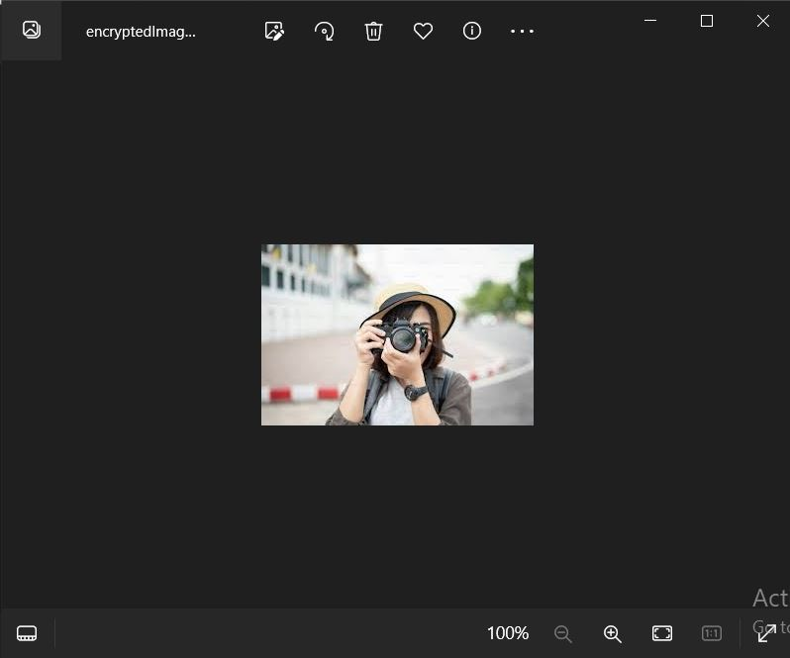
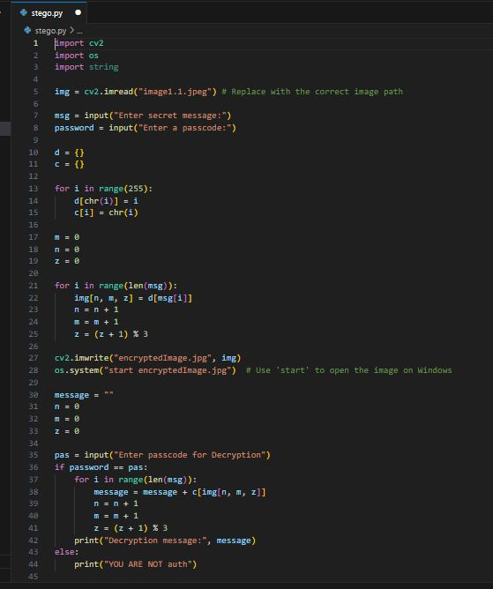
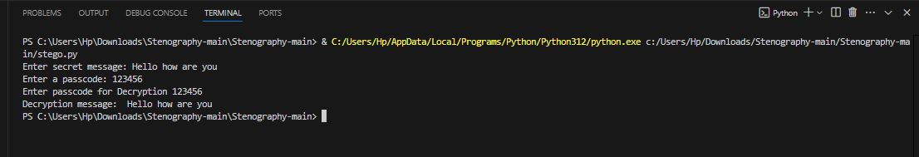
Results

Slide 8
Conclusion
In conclusion, we successfully developed a secure steganography system that embeds and extracts sensitive information within digital images while maintaining the cover image's visual quality. We overcame key challenges in data integrity, confidentiality, and undetectability using techniques like Least Significant Bit (LSB) manipulation. Future work will focus on optimizing algorithms, exploring advanced steganography methods, and applying the system in real-world scenarios.

Slide 9
GitHub Link
https://github.com/NBgami1/AICTE-project.git

Slide 10
Future scope
Enhanced Security Techniques
Applications in the field of cyber security, military and intelligence
Research and Development in industry collaboration
Standardization and Protocols in Legal and Ethical Considerations ,

Slide 11
THANK YOU

